Slide 1
Dr.SNS RAJALAKSHMI COLLEGE OF ARTS AND SCIENCE
(AUTONOMOUS)
Accredited by NAAC (Cycle-III) with ‘A+’ Grade
Department of Mathematics
COURSE :FUZZY LOGIC AND NEURAL NETWORKS
Topic: Truth Table
S.REKHA
Assistant Professor
Dept. of Mathematics
Dr. SNSRCAS

Slide 2
I.
LOGIC CONNECTIVES

Slide 3
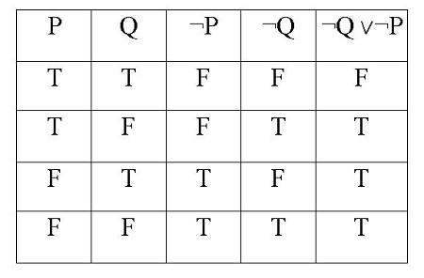
TRUTH TABLE
Construct the truth table for the below problem

Slide 4
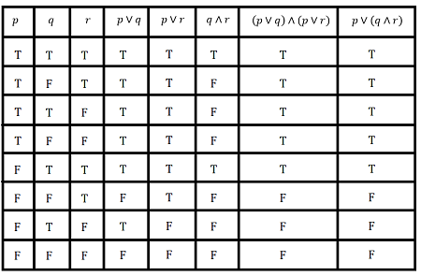
TRUTH TABLE
Construct the truth table for the below problem

Slide 5
THANK YOU

